Slide 1
Jefferies AI Program 2027
JefAI backend infrastructure. AI Harness.
November 2026

Slide 2
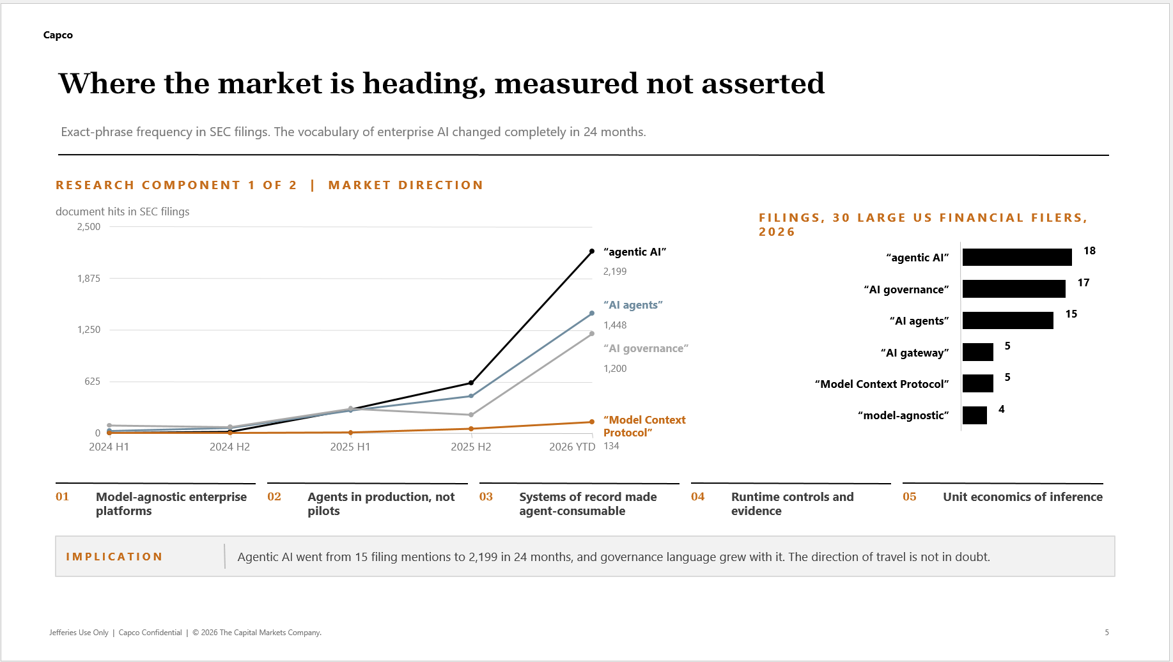

Slide 3
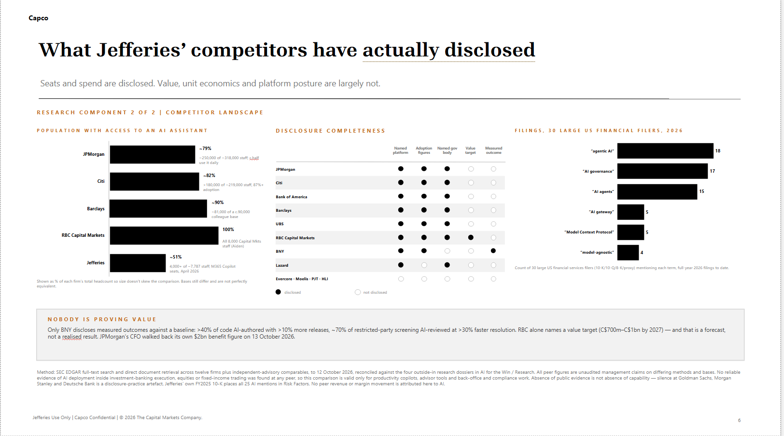

Slide 4
Capco
Capco in the market | relevant financial-services AI experience
Representative Capco experience spans runtime governance, software-defined delivery, enterprise context, operations transformation and agentic data.
U.S. HOUSING FINANCE ENTERPRISE
TIER 1 INVESTMENT BANK
FINANCIAL SERVICES FIRM
GLOBAL BANK
MORTGAGE FINANCE ENTERPRISE
CAPCO PROJECT
CAPCO PROJECT
CAPCO PROJECT
CAPCO PROJECT
CAPCO PROJECT
AI and Agent Runtime Governance
Software-Defined Delivery Transformation
Enterprise Context Layer
Operations Transformation & AI Adoption
Agentic Data Management
Defined agent inventories, permissions and runtime evidence for governed AI execution.
Connected AI-native delivery practices to engineering workflows, developer enablement and throughput.
Grounded AI-centric workflows in governed enterprise context, source lineage and permissions.
Paired operations redesign with role-based adoption, from technical teams into business workflows.
Connected governed data products, metadata and agent access to approved platforms and workflows.
JEFFERIES RELEVANCE
JEFFERIES RELEVANCE
JEFFERIES RELEVANCE
JEFFERIES RELEVANCE
JEFFERIES RELEVANCE
JefAI · governance
Technology adoption
Data/Jupiter · JDS
Project Journey · adoption
Data/Jupiter · agents
Relevant experience, mapped to Jefferies priorities and validated against its platforms, controls and first-wave outcomes.
Client names omitted. Jefferies relevance is illustrative; no client outcome is attributed or transferred.
Notes:
The five project titles shown are the Capco credentials supplied by the user: AI and Agent Runtime Governance — Fannie Mae; Transforming Change Delivery towards SDD — Morgan Stanley; Developing enterprise context layer for reimagined AI-centric business processes — Antares; Operations Transformation and AI Adoption — HSBC; Agentic Data Management — Freddie Mac. Jefferies relevance statements are illustrative mappings, not claims of work delivered for Jefferies; no client outcomes are attributed or transferred.

Slide 5
Capco
Current state | foundations are not yet connected
JefAI, controls, data and priority programs are advancing—but lack one repeatable path to safe adoption, delivery and measurable value.
PROGRAM COMPONENT
JEFFERIES TODAY · EVIDENCE
2027 TARGET · PROPOSED DESIGN
JefAI + AI Harness
Three firm-wide platforms, two gateways and decentralized agent/tool builds. Twenty-nine MCP servers are already built; current materials say the audit log is off by default.
One shared control plane beneath approved tools: model routing, MCP/library registry, identity + entitlements, runtime trace and cost record. Reuse JefAI and Jupiter/JDS assets; no rip-and-replace.
P1
Controls & governance
Responsible-AI, model-risk and cyber controls exist; the current-state review says they do not consistently reach the moment agents call tools and act.
Extend the AI Control Group into runtime: register, risk-tier, approve, enforce user/data/action boundaries, retain evidence and contain/recover. Review depth follows impact.
P2
Business
reengineering
Priority use cases exist, but local proofs and platform work can remain separate from end-to-end process ownership and funding.
Fund two or three sponsor-owned workflows with process baselines, role/decision redesign, human review, engineering, UAT and an accountable benefit owner.
P3
Forward-Deployed Engineering
Technical teams experiment across the firm, but embedded engineering capacity and a repeatable build-to-production path are uneven.
Embed forward-deployed engineers with platform and business teams to integrate approved AI, build reusable components and transfer delivery practices.
P4
Cost & adoption
Technical experimentation and business use are uneven; model and tool spend is not consistently tied to adopted, accepted work.
Train technical and business users by role, track repeat use and accepted outcomes, and manage model/tool cost per workflow against quality and control.
P5
Notes:
Evidence is carried forward from the supplied Jefferies deck (Appendix slides “Where Jefferies stands, October 2026” and “JefAI platform foundations”) and partner strategy-call transcript. The control and governance recommendation is consistent with the FSB Sound Practices for Responsible Adoption of AI, final report, 15 October 2026: https://www.fsb.org/2026/10/sound-practices-for-responsible-adoption-of-artificial-intelligence-ai-final-report/

Slide 6

2027 ambition | trusted AI that improves how Jefferies works
Capco: Govern AI. Scale adoption. Reinvent work. Maximize value—on Jefferies’ governed foundation.
TRUSTED AI AT JEFFERIES SCALE
BUSINESS GROWTH
PRODUCTIVITY
ADOPTION
CONTROLLED SCALE
New and expanded value
Higher efficiency and effectiveness
People, teams and culture
Safe, resilient and sustainable
Establish agentic governance at runtime
Reinvent priority business functions around AI
THE CONTROL SPINE FOR MANAGING RISK AT SCALE
THE VALUE ENGINE FOR HIGHER PERFORMANCE
Automated inventory of agents, tools, identities and dependencies
Material opportunities with executive ownership and baselines
Authority-and-impact classification
Outcome-led redesign of decisions, exceptions and handoffs
Machine-enforced permissions and runtime boundaries
Deliberate human-agent-system allocation
Continuous evidence, detection, containment and recovery
Optimize complete AI costs per accepted outcome
ENABLED BY
ONE GOVERNED AI FOUNDATION
JefAI | JUPITER / JDS | DATA | MODELS | CYBER | COMPLIANCE | GCC
A trusted foundation enables adoption; redesigned workflows convert it into measurable business advantage.
© 2026 The Capital Markets Company. Capco Confidential. All rights reserved.
3
Notes:
This is the FY27 vision house from the supplied Jefferies groundwork deck, preserved as the proposal north star. The program call reinforced a shared JefAI control plane, use of Jupiter/JDS as a connected data and AI capability, workflow-level business ownership, adoption across technology and business roles, runtime controls, and value measures tied to work. The proposed 2027 ambition is to convert those foundations into enterprise outcomes; target measures must be baselined with Jefferies sponsors.

Slide 7





Capco
Executive Summary | FY27 Enterprise AI Program
What Jefferies is aiming for, what is underway, and what it will take to reach controlled enterprise scale.
2027 OUTCOME
JefAI’s backend AI Harness anchors one program for embedded engineering, redesigned work, control and cost-aware adoption.
P1
P2
P3
P4
P5
JefAI + AI Harness
Controls & Governance
Business Reengineering
Forward-Deployed Engineering
Cost & Adoption
JefAI provides the backend foundation; the AI Harness governs approved models, agents, tools and data through identity, policy, telemetry and evidence.
Connect control decisions to runtime, agents, data connectors and releases; keep evidence and approval paths clear.
Redesign sponsor-owned workflows, decisions and handoffs around human and AI work.
Embed engineers with technology and business teams to build, integrate and transfer capability into priority delivery.
Build role-based use and sustained adoption while attributing spend and tracking cost per accepted outcome.
THE EXECUTIVE DECISION
Align on a firm-wide program that connects current priorities to the 2027 vision.
Capco can embed architecture, engineering, workflow redesign, adoption and control integration to close the gap.
Notes:
Executive summary introduces five firm-wide capabilities: JefAI as backend infrastructure with an AI Harness; Forward-Deployed Engineering; Business Reengineering; Controls and Governance; and Cost and Adoption. Adoption is enabled across technical and business users, not presented as a second P2 pillar. The current-priority portfolio is shown on its own slide and is not used to define the vision house.

Slide 8
Capco
FY26–27 priority programs | Enterprise AI impact
AI LEVERS
P
Lead
P
Support
Five major Jefferies initiatives are underway; shared engineering, workflow, control and adoption capabilities support delivery.
P1
JefAI + AI Harness
P2
Controls & Governance
P3
Business Reengineering
P4
Forward-Deployed Eng.
P5
Cost & Adoption
JefAI as control plane
Policy · approvals · evidence
Agentic workflow redesign
Design · build · integrate
Limits · routing · framework
Compliance Tech Refresh
Project Journey
Data / Jupiter (Jupiter)
Cyber Project Glasswing
GCC Build-Out
Remediate identified gaps in Compliance technology
Merged entity with SMBC
JDS data program for 2027
Use frontier models to find and remediate vulnerabilities
End-to-end delivery integrated with the AI program
P1
P2
P3
P4
P1
P2
P3
P4
P5
P1
P3
P4
P5
P1
P2
P4
P5
P2
P3
P4
P5
DELIVER
FDEs build agentic remediation workflows: control mapping, evidence gathering and test scripts.
GCC engineers connect through the same approved data, cyber and compliance guardrails.
Harness becomes the single AI control plane for both entities; SMBC users and models onboard through the gateway.
Agentic support for policy harmonization, data mapping and contract/document reconciliation.
FDEs + Claude Code accelerate pipeline build, code conversion, data-quality rules and lineage documentation.
Expose JDS through governed MCP/data connectors so AI is a day-one consumer.
Harness provides governed access to frontier models across code repositories and infrastructure.
FDEs and GCC engineers help Cyber build find → patch PR → test remediation pipelines.
GCC engineers join the program-aligned pods; build capability with approved AI tools and shared delivery standards.
Connect India delivery with Cyber, Compliance, Data/Jupiter and business teams.
Production
REDUCE
Agentic L1 triage of surveillance alerts and periodic reviews reduces manual review hours.
Reusable MCP tools replace one-off vendor point builds.
Avoid duplicate AI platforms and licenses across entities.
Consolidate model contracts and use one chargeback framework.
AI-assisted conversion and test generation reduce contractor hours.
Route bulk build work to lower-cost models within token limits.
Exploitability-based prioritization shrinks remediation backlog and manual pen-test effort.
Reserve frontier models for deep analysis; use lower-cost models for triage.
AI-augmented delivery raises throughput per engineer.
Track productivity against per-user spend limits.
Cost
MANAGE
LLM Gateway provides a single prompt/output audit trail for books and records.
AI-use inventory and model-risk tiering map to applicable policy and recordkeeping requirements.
Gateway enforces information barriers and entitlements between entities.
Model routing honors cross-border data-residency requirements.
Entitlement-aware retrieval: AI sees only data the user may access.
Automated lineage and metadata strengthen data-governance evidence.
Confine offensive-capable models to an isolated, logged, least-privilege environment.
Harden the AI estate against prompt injection and unsafe agent permissions.
Integrate Cyber, Compliance and Legal reviews with GCC delivery.
Apply the same data access, residency, vendor, support and audit controls across locations.
Risk
Pillar ownership and initiative content preserved from the existing FY27 program matrix. Benefits remain directional; program leads must quantify targets during planning.
Notes:
This native Capco-style crosswalk reconstructs all workstream/pillar mappings and initiative details from the original FY27 Enterprise AI Program | Impact on Firm Priority Programs slide, so the supplied detail remains in the proposal. Program scope, owners and directional benefits are not validated by Capco; confirm with initiative leads. Current naming and project status are from the supplied Jefferies deck.

Slide 9
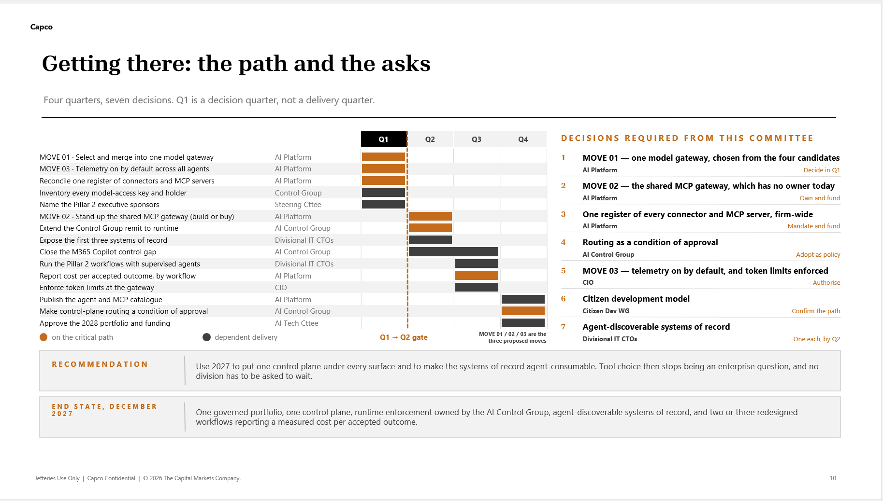

Slide 10
Capco
FY27 target governance | clear roles, connected delivery – What Capco Could help
Jefferies retains sponsorship, governance and approval rights; Capco provides an integrated delivery team across all five pillars.
JEFFERIES AI PROGRAM SPONSOR + STEERING | ACCOUNTABILITY AND DECISIONS
Named sponsor to confirm; discussion referenced Hany Doss / Tim Lyons · sets outcomes and risk appetite · resolves trade-offs · stage-gates work
AI TECH COMMITTEE
AI ARCHITECTURE OFFICE + JEFAI AI HARNESS
AI CONTROL GROUP
TRAINING & DEVELOPMENT / COMMUNICATIONS TEAM
Andrew Ehrlich’s platform remit reports into AI Architecture. Jefferies owns enterprise design, access and standards; JefAI remains the backend AI Harness. Serge’s technical deployment/validation remit also links here.
Daniel + Cyber report into the AI Control Group for model reviews, security approvals and testing. Legal/Compliance + Madi’s vendor review align here; Jefferies approves.
Patrick · Marianne · M. Kim → REPORTS TO AI TECH COMMITTEE
Serge’s team matrix-links here for business enablement / adoption.
ANDREW / PLATFORM + SERGE / TECHNICAL DELIVERY → ARCHITECTURE | CAPCO: AI Architect
DANIEL + CYBER → CONTROL GROUP | CAPCO: control integration + vendor review
CAPCO: BUSINESS REENGINEERING + ADOPTION TRAINERS
CAPCO PROGRAM LEAD | CAPCO DELIVERY REPORTING LINE
Capco pillar leads and pods → Connor for delivery management; Connor provides status/escalations to Jefferies Sponsor + Steering. Jefferies teams retain their own reporting lines and decision rights.
P1 · JEFAI + AI HARNESS
P2 · CONTROLS & GOVERNANCE
P3 · BUSINESS REENGINEERING
P4 · FORWARD-DEPLOYED ENGINEERING
P5 · COST & ADOPTION
CAPCO · AI / Enterprise Architect
CAPCO · Control Integration PM Support
CAPCO · Business Requirements Lead
CAPCO · FDE Tech Lead + Engineers
CAPCO · Adoption / Value Lead + Trainers
Jefferies partner: AI Architecture Office + platform owners. Advises on runtime, API and connector standards; Jefferies owns design decisions.
Jefferies partner: AI Control Group, Daniel + Cyber, Risk and Legal/Compliance. Connects policy to runtime evidence; Jefferies approves.
Jefferies partner: sponsor + process owner. Sets workflow baseline, target process, requirements and human review.
Jefferies partner: technology owners + SMEs. Builds, integrates, tests and transfers; Jefferies retains production support.
Jefferies partner: AI Tech Committee, business/tech users and Finance. Trainers coach L1–L3; Tableau tracks use, outcomes and cost.
FIVE-PILLAR DELIVERY PATH
Jefferies prioritizes → P3 redesigns → P4 engineers + validates → P2 approves release → P5 measures value; P1 underpins every step. Capco delivers through Connor’s integrated team.
CONTINUOUS ENABLEMENT | TECHNICAL + BUSINESS USERS
Capco trainers coach approved personal, team and enterprise use as capabilities mature. Jefferies owns access, process decisions, outcomes and production support.
GCC
Blended capacity follows approved backlog and data-access constraints.
CYBER + COMPLIANCE
Connected through the AI Harness and release gates.
TABLEAU
Repeat use · accepted output · quality · full cost.
Notes:
The partner call described FY27 as a firm-wide program connecting JefAI, Jupiter/JDS, Compliance, Cyber, GCC and Project Journey through shared platform capabilities. Jefferies retains business priorities, architecture and control approvals, and production decisions. The AI Tech Committee prioritizes use cases and end-user needs; the Enterprise AI Program integrates portfolio/value gates with platform, architecture, access and standards; the AI Control Group owns risk and control review. Proposed Capco roles: one accountable AI Program Lead; a JefAI/AI architect who advises on backend, harness, models, tools and data; a Business Reengineering Lead who works hands-on with owners to redesign end-to-end workflows and business cases; and an Adoption & Learning Lead who builds from technology users to business roles and enterprise practice. Four joint pods align to Compliance Refresh, Project Journey, Data/Jupiter/JDS and Cyber, with GCC capability across pods. Cyber, Legal/Compliance, IT Risk, licensed data and entitlements connect through the harness; Capco conducts vendor review and Jefferies retains approval rights. Tableau is proposed as a permissioned value/adoption view. Confirm committee membership, staffing, baselines and architecture decisions with Jefferies.

Slide 11
Capco
Governance today | active forums, distributed accountability
Executive and steering forums set priorities, but delivery teams remain distributed across separate functional reporting lines.
CURRENT GOVERNANCE FLOW | EXECUTIVE OVERSIGHT → STEERING PRIORITIES
EXECUTIVE COMMITTEE / STERRING COMMITTEE
Bodies do not exist in current program structure
CURRENT FORUMS | PRIORITIZATION, STATUS COORDINATION AND CONTROL REVIEW
AI TECH COMMITTEE
PROGRAM GOVERNANCE / ENTERPRISE AI
AI CONTROL GROUP
Steering priorities flow here. Prioritizes Enterprise AI workloads and JefAI team activity. Represented by FI, EQ, Corporate, Risk, Infrastructure, Security, and IB CTOS
Collects updates from Enterprise Workstream Owners and enables cross-workstream delivery
Policy/compliance oversight and guardrails, Cyber conduct model reviews, security approvals and testing
CURRENT WORKSTREAMS | DISTINCT TEAMS AND FUNCTIONAL REPORTING
JefAI / AI Platform
Data & Integration
AI Tooling
Cyber / Security
Enterprise AI team develops platform services and APIs. Workload priority comes from the AI Tech Committee.
Data & Integration; also interfaces across platform and security.
DAI tooling and enablement for the enterprise system.
Cyber model reviews, security approvals and security-level testing.
End-user Enablement
Training & Comms
Legal / Compliance
Vendor Management
User-side model validation, deployment and end-user enablement.
PTraining and communications function.
Policy and compliance review; Capco supports current review activity.
Capco-owned vendor review; separate from enterprise AI reporting today.
CAPCO EMBEDDED TODAY
AI Program Lead | JefAI Product Owner | Capco Legal/Compliance + Vendor Review
CURRENT GOVERNANCE ACCOUNTABILITIES
AI Tech sets Enterprise AI/JefAI priorities, Program Governance coordinates workstream updates, and the AI Control Group oversees policy, compliance and security review. Executive and steering oversight is not formalized in the current program structure; delivery teams retain their functional reporting lines.

Slide 12
Capco
P1 + P2 | JefAI becomes the governed AI Harness
Keep JefAI as shared backend infrastructure. Put identity, policy and evidence on the execution path.
P1 JefAI + Harness
P2 Controls & Governance
P3 Business Reengineering
P4 Forward-Deployed Eng.
P5 Cost + Adoption
PEOPLE + DELIVERY TEAMS
JEFAI · SHARED RUNTIME CONTROL
CONNECTED SERVICES
Approved entry points
One governed execution path
Model gateway
•
Approved AI applications and productivity tools
01
Identity + entitlements
Resolve user or service identity; enforce source permissions on each request.
Approved model routes, limits and per-call telemetry.
›
›
Agent / MCP register
•
Engineering, business users and AI agents
02
Policy + routing
Apply risk tier, allowed models and tools, spend limits and human approval points.
Owner, risk tier and lifecycle. Make approved use cases discoverable in the harness.
•
GCC delivery teams under shared standards
Jupiter / JDS + firm systems
03
Trace + cost record
Capture model, connector, data access, action, output, exception and cost by default.
Permissioned connectors preserve source entitlements.
Jupiter / JDS supplies governed context and data services.
PROGRAM + COMMITTEE DECISION RIGHTS
Capco AI Program Lead coordinates the integrated plan; Capco AI / enterprise architect advises. Jefferies owns architecture standards and decisions.
AI Tech Committee prioritizes business needs. AI Control Group, Cyber, Data, Legal/Compliance and IT Risk set controls and approvals.
FIRST CONTROLLED SLICE
01
Choose gateway + owner
02
Register first connectors
03
Enable default-on trace
04
Connect one workflow
Notes:
P1 and P4 deep dive. JefAI remains the shared backend infrastructure and governed runtime path across approved tools, agents, data products and GCC delivery. The target adds default-on traces, identity and entitlement enforcement, policy-based model/tool routing, spend limits, an owned register and discoverable use cases. The Enterprise AI Program coordinates platform architecture and standards with a Capco technical lead advising. The AI Tech Committee prioritizes business demand and end-user requirements; the AI Control Group governs risk and approvals.

Slide 13
Capco
P3 + P4 | redesign the workflow, then engineer it
Business owners define the target process and outcome first; forward-deployed engineers build, integrate and prove the approved design.
P1 JefAI + Harness
P2 Controls & Governance
P3 Business Reengineering
P4 Forward-Deployed Eng.
P5 Cost + Adoption
P3 · SELECT & BASELINE
P3 · REDESIGN THE WORK
P4 · BUILD & PROVE
Choose the workflow
Set the target process
Engineer the solution
BUSINESS OWNER + SPONSOR
BUSINESS + TECHNOLOGY
FORWARD-DEPLOYED ENGINEERING
Tech Committee prioritizes a sponsor-owned workflow with a process owner, baseline and measurable outcome.
Redesign decisions, roles, exceptions and human review around the work to improve.
Build, integrate, test and document against approved JefAI / AI Harness patterns.
WHO OWNS THE DECISION
WHO OWNS THE DECISION
WHO OWNS THE DECISION
Capco reengineering lead captures time, quality, cost and handoffs; Jefferies validates the baseline.
Business owners approve process choices, escalation points and human accountability.
Jefferies technology owners and SMEs validate UAT, security and production handoff.
ADOPTION AND LEARNING CONTINUE ACROSS THE PROGRAM
TECHNICAL USERS
BUSINESS USERS
Jefferies technology owners set standards and release decisions. Capco engineers pair on integration, testing, reusable patterns and capability transfer.
Jefferies sponsors and process owners choose the work, accept the redesign and validate outcomes. Capco facilitates process discovery and UAT.
BUSINESS REENGINEERING · FROM BASELINE TO AGENTIC WORKFLOW
Prioritize + baseline
Redesign
Engineer + UAT
Transfer + reuse
Owner · time · quality
Roles · decisions · review
Integrate · test · prove
Train · support · learn
P5 learning spans technical and business users at personal, team and enterprise levels; track accepted work, quality, control and cost before scaling.
Notes:
P2 and P3 deep dive. Adoption progresses from personal productivity to team applications to enterprise applications and runs across the program. The technical track covers safe tool use, secure engineering, JefAI integration, and model/token cost optimization. The business track covers daily productivity, citizen developers, workflow adoption, and enterprise change. Capco trainers support both tracks. Business reengineering partners with sponsors to redesign agentic workflows, with Jefferies owning process decisions and outcomes. Level and risk labels reflect the supplied Jefferies governance screenshot.

Slide 14
Capco
P5 | adoption and unit economics guide scale decisions
Capco trainers grow safe use across technical and business users; Tableau connects repeat use, accepted outcomes and full cost.
P1 JefAI + Harness
P2 Controls & Governance
P3 Business Reengineering
P4 Forward-Deployed Eng.
P5 Cost + Adoption
FIVE VALUE SIGNALS
TABLEAU · VALUE COCKPIT
SIGNAL
WHAT TO TRACK
OWNER
Adoption
Active and repeat use across technical and business roles; L1 personal, L2 team, L3 enterprise
Business
UNIT ECONOMICS
Cost per accepted outcome
Productivity
Time to accepted output; process cycle time
Workflow owner
Model + platform + delivery + run cost
Business-accepted outputs
Quality + control
Acceptance, rework and control exceptions
Business + Risk
SPEND CONTROLS
Route by quality, risk and cost. Set work-package limits and alerts. Attribute spend to model, tool, workflow and team.
Business impact
Capacity, client, revenue or risk outcome set for each case
Sponsor
QUARTERLY PORTFOLIO GATE
SCALE
ADAPT
STOP
Unit economics
Full model, platform, delivery and run cost per accepted outcome
Finance + Tech
Value, controls and adoption support scale
Fix workflow, model or support gap
Evidence does not support more spend
Tableau reports approved telemetry and workflow data; source entitlements remain in force. Jefferies sets access and scale gates.
COST + ADOPTION
Train and coach across technical and business roles; attribute model, tool, platform and run spend; compare full cost per accepted output to the agreed baseline.
Notes:
P5 deep dive. Tableau is proposed as a value reporting layer over approved platform telemetry and workflow data, not as a control plane or source of entitlements. Measures require named owners and baselines. Cost per accepted outcome includes model, platform, delivery and run costs. Per-work-package limits, alerts and cost attribution make spend management operational. Scale, adapt or stop decisions should also consider quality, adoption and control readiness.

Slide 15
Capco
Mobilization dependencies | five capability owners clear the start gate
Each pillar needs an owner, specific access and evidence before the first work package starts.
P1 · JefAI + Harness
P2 · Controls & Governance
P3 · Business Reengineering
P4 · Forward-Deployed Engineering
P5 · Cost & Adoption
UNLOCK
UNLOCK
UNLOCK
UNLOCK
UNLOCK
AI Architecture Office and Capco AI/Enterprise Architect; gateway and registry decisions; environments, identity and connector access; Jupiter/JDS path.
AI Control Group route; Cyber, Data, IT Risk and Legal/Compliance; licensed data; vendor review; GCC security and support.
Named business sponsor and SMEs; workflow baseline; UAT time; authority to change decisions, handoffs and roles.
Embedded engineering cohort and SMEs; backlog priorities, sprint capacity, platform credentials, nonproduction environments and access paths.
Finance / COO sponsor; Tableau reporting owner; model, platform, delivery and run-cost inputs; outcome definition.
READY WHEN
READY WHEN
READY WHEN
READY WHEN
READY WHEN
One approved route, named connector owners and default-on runtime telemetry are available.
Risk tier, entitlements, evidence and release approvals are agreed. Capco leads vendor review; Jefferies retains approval.
Process owner accepts target workflow, human review and outcome measure.
FDE capacity is assigned to approved work, with build, integration, testing and handoff standards agreed.
Baseline and KPI owner are agreed, with a scale / adapt / stop threshold.
MOBILIZE WHEN
Named sponsor + first-wave scope + platform access + approved control path + baseline + staffed capacity + decision rights.
Notes:
Mobilization dependencies map to the five program capabilities. P4 explicitly connects the AI Control Group with Cyber, Data, IT Risk and Legal/Compliance, licensed data, vendor review and GCC security/support. The user confirmed Capco currently owns vendor review and Jefferies retains approval. The AI Tech Committee focuses on business priorities and end-user requirements. GCC should connect to the common platform and controls. Confirm owners, access, baselines and committee routing before mobilizing work packages.

Slide 16
Capco
Commercials | proposed capacity and fees follow the first wave
Pricing structure is ready for completion after scope, delivery levels and mobilization conditions are agreed.
ONE PROGRAM | PHASED WORK PACKAGES
ENGAGEMENT OUTCOMES
PROPOSAL SUMMARY
LEVEL / CAPACITY
USD
One Capco AI Program Lead connects the five pillars, governance and delivery gates.
Capco AI Program Lead · cross-pillar
To be confirmed
TBD / day
01
P1 · AI / Enterprise Architect
To be confirmed
TBD / day
02
Architecture and engineering capacity advances JefAI / AI Harness and sponsor-backed workflows.
P2 · Controls Integration + Vendor Review
To be confirmed
TBD / day
03
Business redesign and Capco trainers grow technical and business adoption from L1 to L3.
P3 Requirements / Reengineering + P5 Trainers
Sized to backlog
TBD / day
04
Cyber, Data and Compliance connect to delivery; GCC capacity follows shared standards.
P4 · Forward-Deployed Engineering capacity
Sized to backlog
TBD / day
05
Tableau reports adoption, outcomes, quality, control and cost signals for scale decisions.
Scope, duration and delivery days
To be scoped
To be scoped
Estimated total fees
—
TBD after scope
MOBILIZATION UNLOCK
Confirm sponsor, first-wave scope, platform access, control approvals, baseline and capacity. Then complete role levels, delivery days, duration and fees.
Notes:
Commercial page uses the supplied pricing-table structure. Rate, level, duration, delivery days and total fees remain placeholders because the user instructed that confidential investment amounts must not appear. Complete these after scope, first-wave readiness and capacity are agreed.

Slide 17
Appendix

Slide 18
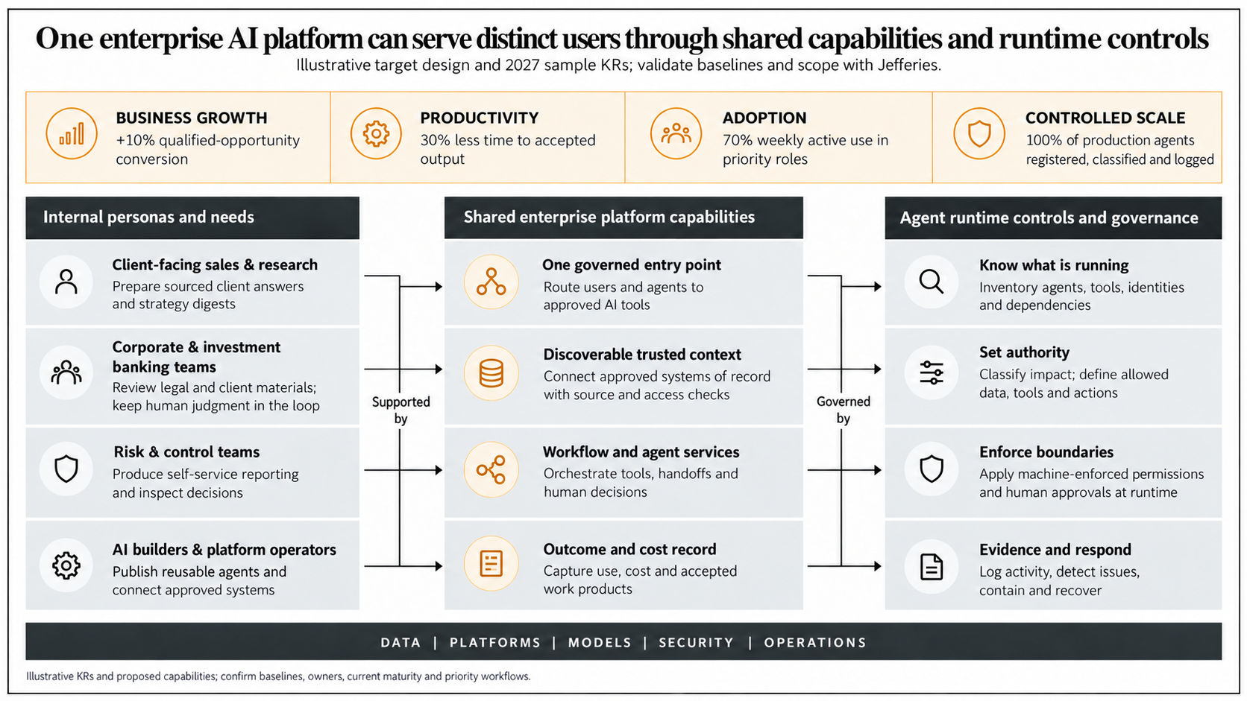
The enterprise AI platform must serve distinct users through shared capabilities and runtime controls
Illustrative Outcomes
BUSINESS GROWTH
PRODUCTIVITY
ADOPTION
CONTROLLED SCALE
X% more qualified client opps
advanced to active pursuit
X% less time to accepted output
X% weekly active use in priority roles
X% of production agents inventoried and classified
Internal Personas and Needs
Shared enterprise platform capabilities
Agent runtime controls and governance
Client-facing sales & research
One governed entry point
Know what is running
Prepare sourced client answers
and strategy digests
Route users and agents to
approved AI tools
Inventory agents, tools, identities
and dependencies
Investment banking
Discoverable trusted context
Set authority
Review legal and client materials;
keep human judgment in the loop
serves
Connect approved systems of record
with source and access checks
governs
Classify impact; define allowed
data, tools and actions
Risk & control teams
Workflow and agent services
Enforce boundaries
Produce self-service reporting
and inspect decisions
Orchestrate tools, handoffs
and human decisions
Apply permissions and human
approvals at runtime
Technology builders & operators
Outcome and cost record
Evidence and respond
Publish reusable agents and
connect approved systems
Capture use, cost and accepted
work products
Log activity, detect issues,
contain and recover
DATA | SORs | MODELS | SECURITY | OPERATIONS

Slide 19
Typical governance models we encounter in FS are more focused on risk governance and oversight
ENTERPRISE GOVERNANCE
AI CONTROL GROUP AND EXECUTIVE OVERSIGHT
An executive sponsor sets priorities and risk tolerance. The AI Control Group maintains standards, inventory and review routing; control functions challenge material decisions.
COMMON FOUNDATION
Inventory, policy, delegated authority, risk appetite, control evidence and escalation
EXECUTIVE PRIORITIES
OPERATIONAL OVERSIGHT
MATERIAL RISK ESCALATION
EXECUTION AND CONTROL
BUSINESS & DIVISIONAL IT
AI CONTROL GROUP
AI PLATFORM & SECURITY
Owns the use case, business outcome, supervision and service continuity.
Classifies uses, routes challenge and approvals, and records exceptions.
Enforces permissions and human gates; logs activity and enables containment.
Business sponsor + use-case owner
AI Control Group lead
Technology + security leads
RISK COVERAGE AND FUNCTIONAL OWNERS
AI Program
AI Risk & Controls
Cyber
Third Party
Operational Resilience
Technology
Data & Privacy
Program office
First-line risk
Security
Vendor risk
Resilience lead
Engineering
Data and privacy
Inventory, value
Controls, exceptions
Adversarial use
Supplier reliance
Availability, recovery
Reliability, tools
Leakage, quality
Model
Legal
Compliance & Regulatory
Conduct & Ethics
Fraud
Human Capital
Insider Risk
Model risk
Legal
Compliance
Conduct risk
Fraud risk
Human resources
Insider risk
Testing, drift
IP, contracts
Obligations, records
Bias, fairness
Impersonation
Skills, role change
Misuse, exfiltration

Slide 20
Adapting the model for Jefferies means linking business ownership, independent challenge and runtime control
ENTERPRISE DIRECTION AND ESCALATION
Executive sponsor and existing steering forum set priorities and risk tolerance, delegate approval authority, and resolve material exceptions
BUSINESS & DIVISIONAL IT
AI CONTROL GROUP & PLATFORM
CONTROL FUNCTIONS & AUDIT
First line ownership
Shared control plane
Second line challenge; third line assurance
Business sponsor and use-case owner
AI Control Group
Relevant control functions
Own the outcome, client impact, supervisory process and allowed AI actions
Registers uses and agents, assigns authority and impact tier, routes review and records exceptions
Risk, Compliance, Model Risk, Legal, Cyber, Privacy and Third Party Risk challenge according to risk tier
Divisional technology
AI Platform
Internal Audit
Owns integration, release, service continuity and recovery
Enforces identity, data, tool and action limits; retains runtime evidence and enables containment
Independently tests the design and operation of the framework
Accept outcomes and residual risk within delegated authority
Confirm control design before production release
Escalate gaps; sign off where policy requires
CONTROL PATH SCALES WITH AUTHORITY AND IMPACT
01 REGISTER
02 CLASSIFY & APPROVE
03 ENFORCE
04 EVIDENCE & RESPOND
Use, owner, tools and data
Risk tier, testing and decision
Permissions, human gates and limits
Logs, review, stop and recover
Review depth increases for client-facing, market-affecting, sensitive-data or autonomous uses.

Slide 21
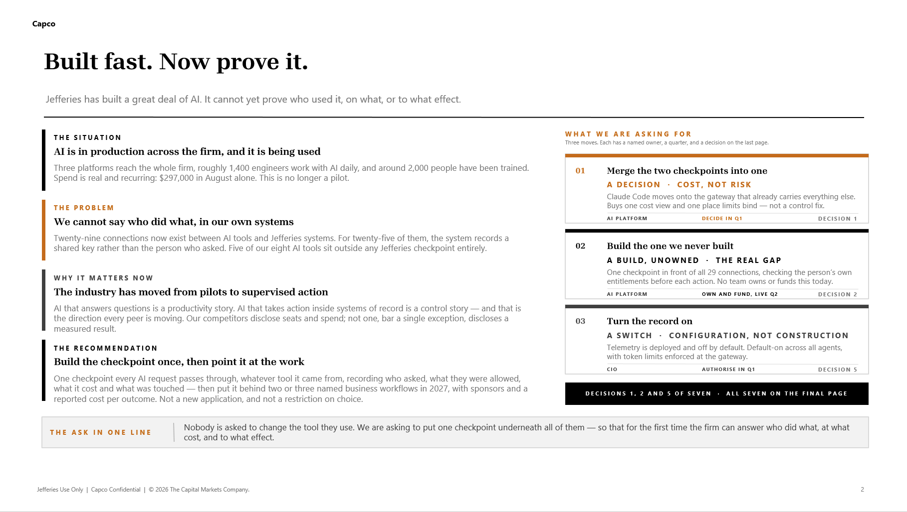

Slide 22
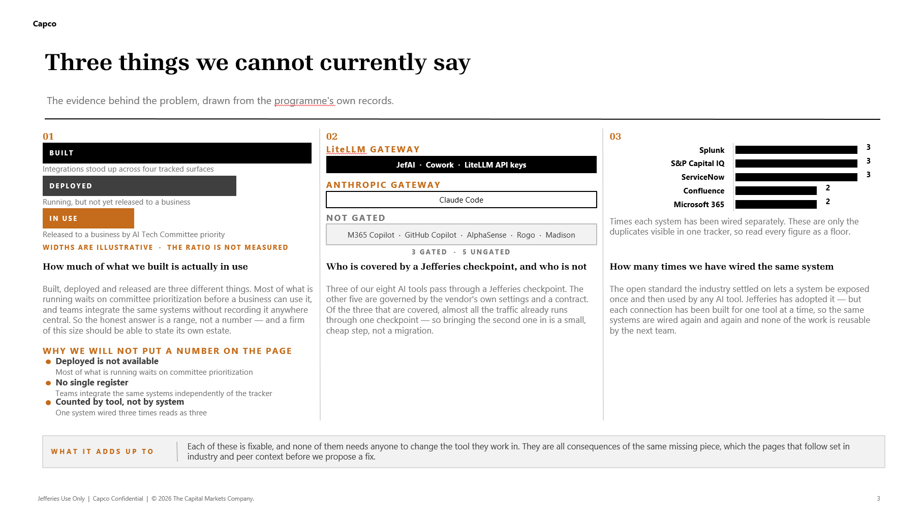

Slide 23
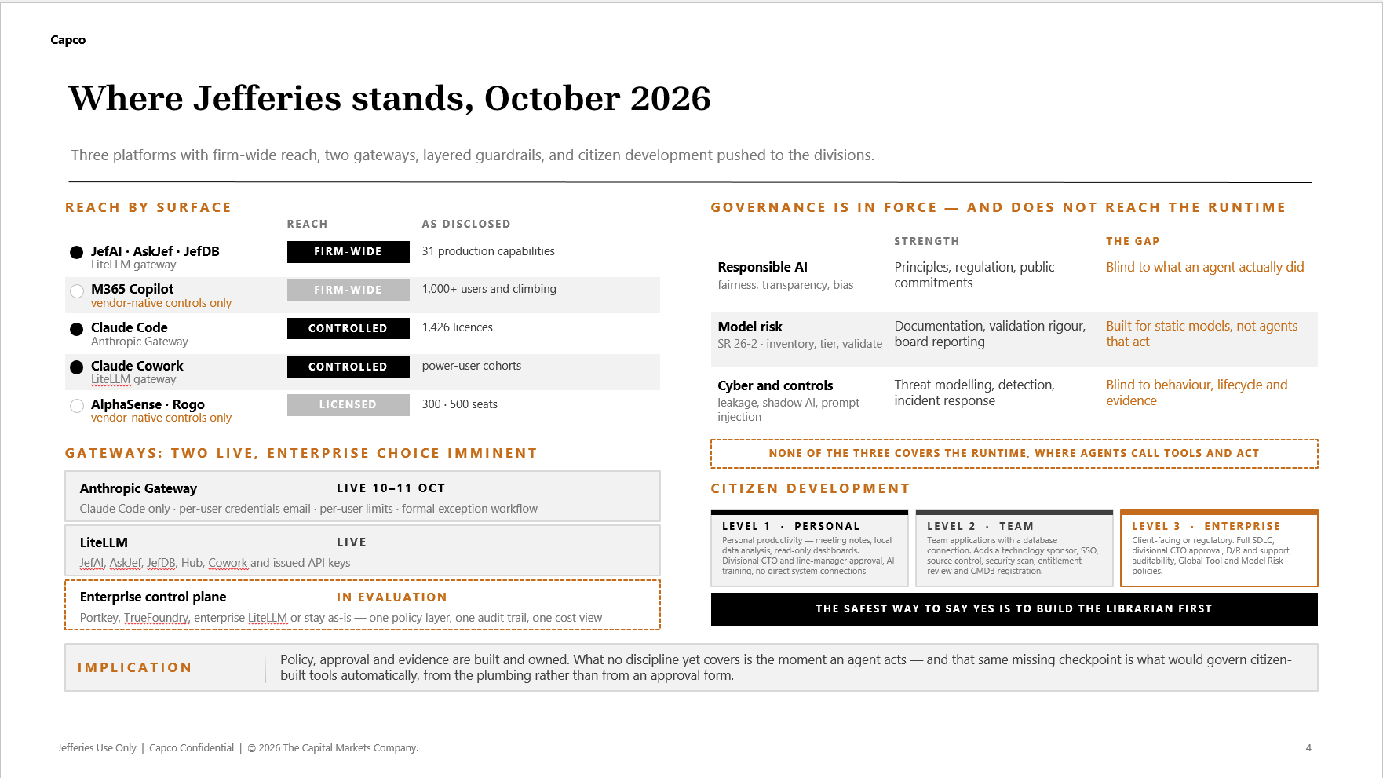

Slide 24
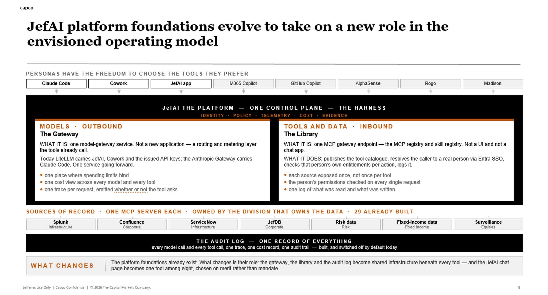

Slide 25


